Slide 1

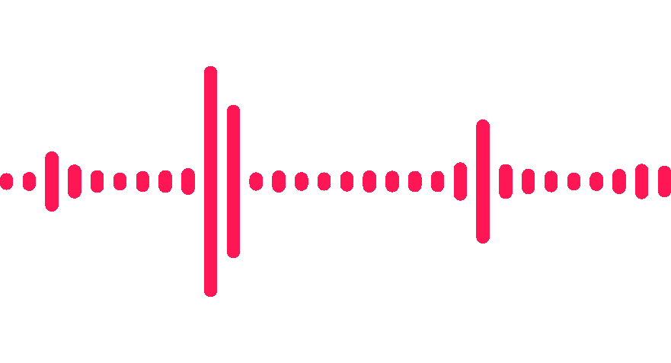
18th April 2024
Deepfake Audio Detection:
A Supervised Machine Learning Approach
Presented By:
Sean Minezes A015
Diya Rawat A018
Veer Shah A020
Udita Sinha A025
Jeel Paradava A034
Mentored by: Prof Shraddha Sarode

Slide 2


Can you guess which one is AI generated and Human

Slide 3
Can you guess which one is AI generated and Human
HUMAN
AI

Slide 4
INTRODUCTION
As deepfakes and synthetic media become more common, it's crucial to distinguish AI-generated from human audio.
This project aims to develop a strong machine learning model for precise audio source identification.
Our goal is to create a reliable tool to authenticate audio material using supervised learning, feature extraction, and rigorous evaluation.

Slide 5

APPLICATIONS
Secure voice authentication systems like phone unlocking by identifying real users from AI mimics.
2. Safeguard against deepfakes by helping social media platforms weed out malicious content before it spreads.
3. Detect AI-generated calls designed to trick users into revealing personal information or sending money.
4. Protect celebrities from voice impersonation on social media, preventing scams and manipulation.

Slide 6
OBJECTIVE
To build a supervised classification model to detect the Human and AI generated Speech, applying and comparing various models and their accuracy.

Slide 7
CONTENTS
METHODOLOGY
CONCLUSION
BIBLIOGRAPHY
1
2
3
4
5
6
DATA DESCRIPTION
RESULTS
LIMITATIONS & FUTURE SCOPE

Slide 8
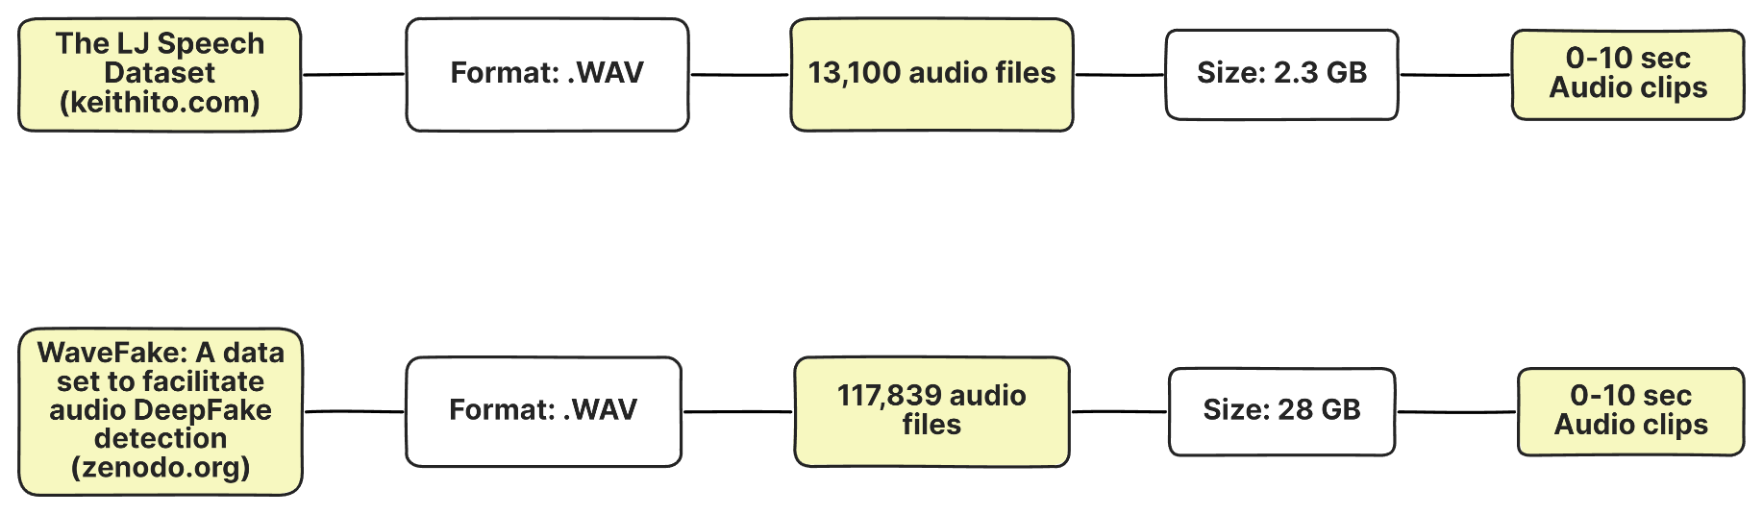
DATA DESCRIPTION
Human Speech
AI generated Speech

Slide 9
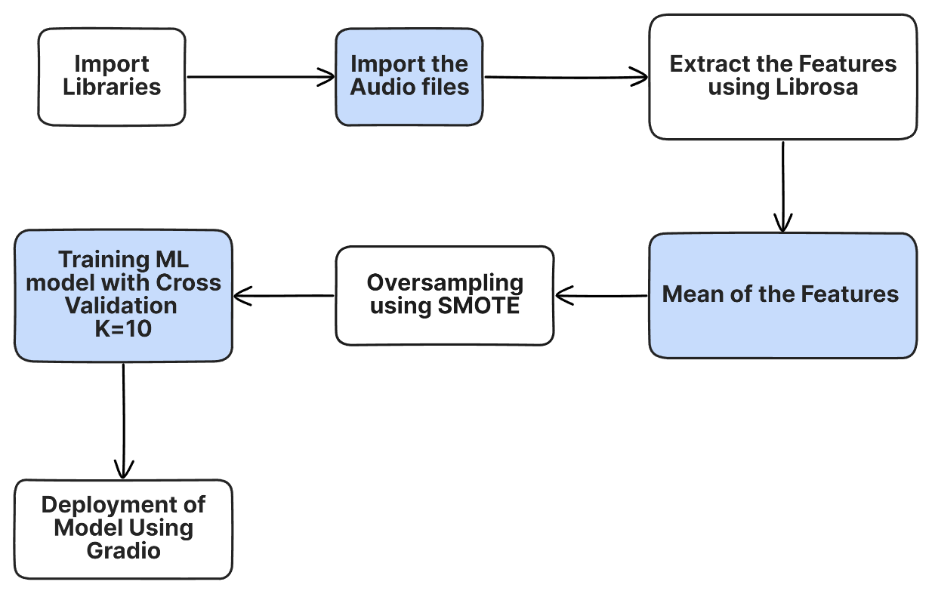
METHODOLOGY

Slide 10

Librosa: Allows us to load audio files and examine them over time, amplitude & its frequency content. It also helps us extract specific characteristics to reveal unique information about the audio.
MFCC
20
Chromagram
12
Spectral Contrast
7
Tonal Contrast
6
Mel-frequency cepstral Coefficients provide detailed insights into different frequency bands.
Represent the energy distribution of musical notes in the audio signal,offering insights into the presence and proportion of different musical notes
Amplitude difference between Peak and valleys. Catches distinctness of different Frequency regions
Focus on the harmonic content of the audio signal. They calculate the average pitch and its spread within the chromagram

Slide 11
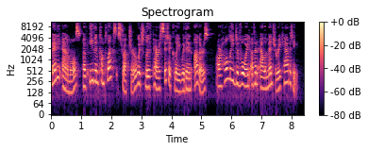
SPECTOGRAM
Visual representation of the frequency content of a signal over time, displaying how the intensity of different frequencies changes with time.
Decibel Scale (Db) measures Intensity/Amplitude
Time Frames (in seconds) on X-axis
Frequency (in hertz) on left Y-axis
Intensity on right Y-axis

Slide 12
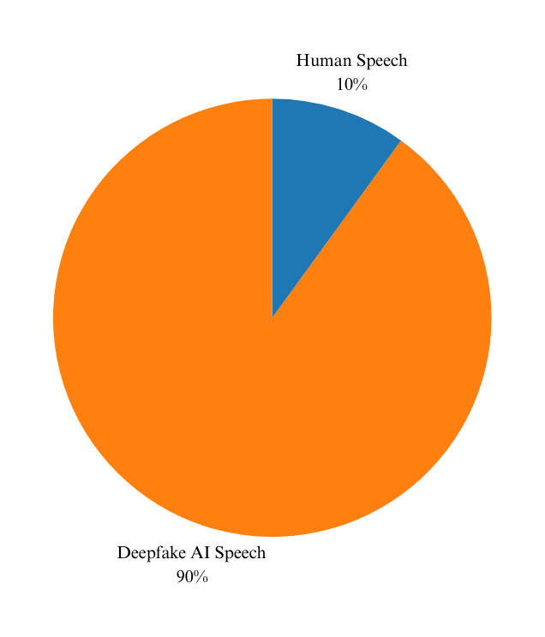
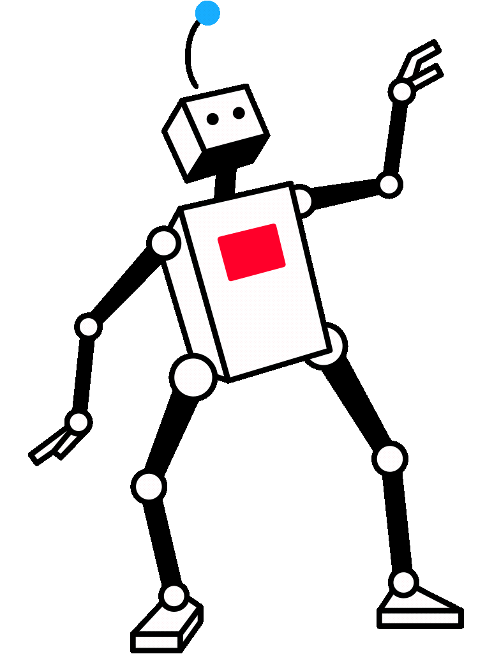
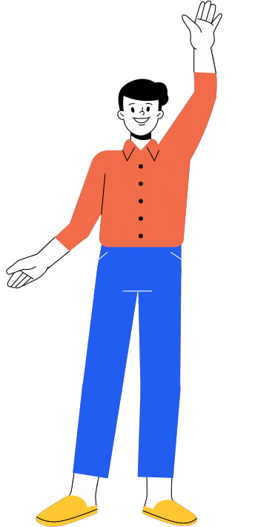
DISTRUBUTION OF TARGET VARIABLE

Slide 13
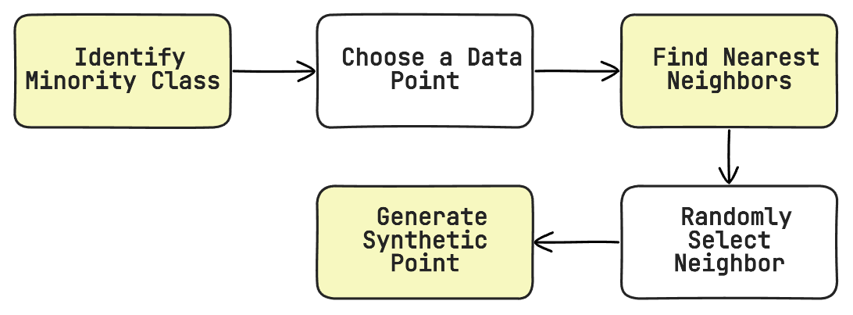
SYNTHETIC MINORITY OVERSAMPLING TECHNIQUE (SMOTE)
SMOTE boosts model learning from underrepresented classes by creating new instances for the minority class without duplicating existing data.
Here the minority class is human with 131083 instances.
Hence, now the dataset is balanced - [235966,47] with total 235966 audio rows and 45 feature columns

Slide 14
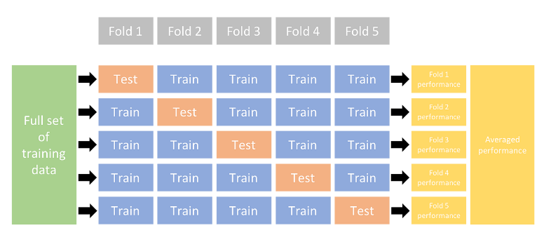
CROSS VALIDATION K = 10 FOLD
Cross-validation is a technique for evaluating a machine learning model and testing its performance.

Slide 15
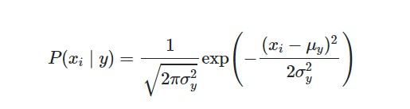
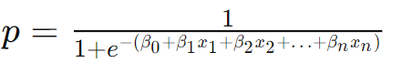
Gaussian Naive Bayes Model
Logistic Regression Model
Based on Bayes' theorem. Calculates the probability of a certain event occurring given prior knowledge.
Predicts probability of an instance belonging to a particular category using a linear relationship between the features and the log-odds of the target variable. Value is between 0 and 1 .

Slide 16
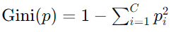
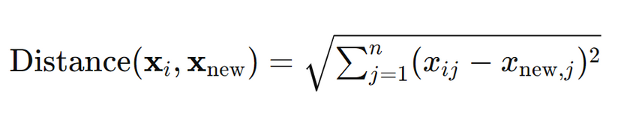
Decision Tree Model
KNearest Neigbors Model
Make decisions by asking a series of questions about the input features and predict the target variable based on the answers, making them intuitive and easy to interpret. Split the variable with the least gini index
Predicts the class of a new instance based on the majority class among its k nearest neighbors in the feature space i.e. measures Distance between K nearest Neighbours

Slide 17
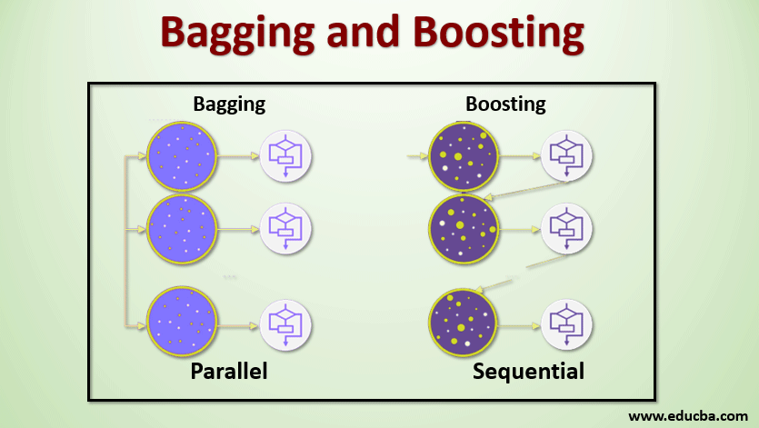
Random Forest Model
Bootstrapping with decision trees
XG Boost Model
Boosting with decision trees (Weak learners)

Slide 18
RESULTS
ML Models | Accuracy | Precision | Recall | F1 score
Random Forest | 0.98 | 0.97 | 1 | 0.98
Decision Tree | 0.96 | 0.97 | 1 | 0.96
Xgboost | 0.92 | 0.87 | 1 | 0.93
Naive Bayes | 0.79 | 0.72 | 0.93 | 0.81
KNN | 0.74 | 0.66 | 0.97 | 0.79
Logistic Regression | 0.66 | 0.63 | 0.79 | 0.70

Slide 19
RESULTS
BEST ML MODEL - RANDOM FOREST
Best Model | Accuracy | Precision | Recall | F1 score
Random Forest | 0.98 | 0.97 | 1 | 0.98
- Achieves a high accuracy of 98%.
- Precision of 0.97 indicates strong correctness in positive predictions.
- Perfect recall score of 1.00 shows the model correctly identifies all positive instances.
- F1 score of 0.98 demonstrates a balanced performance between precision and recall.
- Overall, the Random Forest model excels in accuracy, precision, recall, and F1 score, making it well-suited for classification tasks.

Slide 20
CONCLUSION
Analyzed audio to differentiate real from AI-generated voices (45 features extracted).
Addressed dataset imbalance using Synthetic Minority Oversampling Technique (SMOTE)
Built a tool to fight deepfakes and secure voice applications.

Slide 21
New Concepts Learnt
Librosa library in python
Audio features - MFCC, Spectral contrast chromagram & Tonal contrast
XG Boost Model
Gradio - Web app development

Slide 22
LIMITATION & FUTURE SCOPE
Expanding feature extraction for deeper audio comprehension.
Utilizing CNNs, RNNs, and other neural networks for efficient model development.
Increasing the availability of human-labeled data.
Acquiring up-to-date AI-generated data for real-time audio classification and detection, paving the way for future advancements.

Slide 23
BIBLIOGRAPHY
S. Team, “Reports - Sensity AI,” Sensity, Dec. 05, 2023. https://sensity.ai/reports/
Dessa, “Detecting audio deepfakes with AI - dessa news - medium,” Medium, Dec. 12,2021.[Online].Available:https://medium.com/dessa-news/detecting-audio-deepfakes-f2edfd8e2b35
The LJ Speech Dataset (keithito.com)
WaveFake: A data set to facilitate audio DeepFake detection (zenodo.org)
Feature extraction — librosa 0.10.1 documentation
R.Wells,“Upsampling and Downsampling Imbalanced Data in Python,”wellsr.com. https://wellsr.com/python/upsampling-and-downsampling-imbalanced-data-in-python/

Slide 24
THANK YOU!
By:
A018 Diya Rawat
A034 Jeel Paradava
A015 Sean Minezes
A025 Udita Sinha
A020 Veer Shah

